Slide 1


CN PROJECT
CN PROJECT 1

Slide 2
CN PROJECT
GROUP MEMBERS
AKSHAYA CHOUDARY 2023000420
DIRGHA DUTTA 2023000335
SANJANA DASARI 2023000377

Slide 3

CN PROJECT
HTTP AND WEB SERVICES
Our primary goals are to:
Set up a network with a web server and clients.
Configure and analyze HTTP communication.
Simulate web traffic.

Slide 4
CN PROJECT
HTTP
HTTP - (Hypertext Transfer Protocol)
It is a protocol used for transfering data or information between web servers and client devices (browsers).

Slide 5
CN PROJECT
WEB SERVICES
A Web service is a method of communication between two electronic devices over a network, typically the internet.

Slide 6
CN PROJECT
Importance and key features of HTTP
Foundation of the Web: HTTP enables communication between browsers and servers to serve content.
Global Accessibility: It ensures worldwide access to resources and services.
Request-Response Model: Clients send requests, and servers return responses.
Stateless: Each request is independent, simplifying communication and scalability.
Content Flexibility: HTTP supports various data types (HTML, images, JSON, XML).

Slide 7
CN PROJECT
Importance and key features of Web based applications
Interoperability: Web services enable seamless communication between different applications, regardless of platform or language.
Scalability: They handle increasing numbers of clients and requests, making it easy to scale.
Standardized Communication: Web services use open standards (e.g., SOAP, REST, XML) for compatibility and reduced technical barriers.
Platform Independence: Web services work across diverse platforms and languages, offering flexibility.
Loose Coupling: Web services are independent, allowing changes in one system without affecting others.

Slide 8
CN PROJECT
Integrating Web Services with HTTP:
Remote Access: HTTP allows clients to access web service data remotely.
Standardized Communication: HTTP ensures smooth data exchange between platforms.
Scalability: HTTP enables efficient handling of high traffic and requests.
Easy Integration: HTTP simplifies the integration of web services with various systems.
Security: HTTPS ensures secure data transfer between clients and web services.

Slide 9
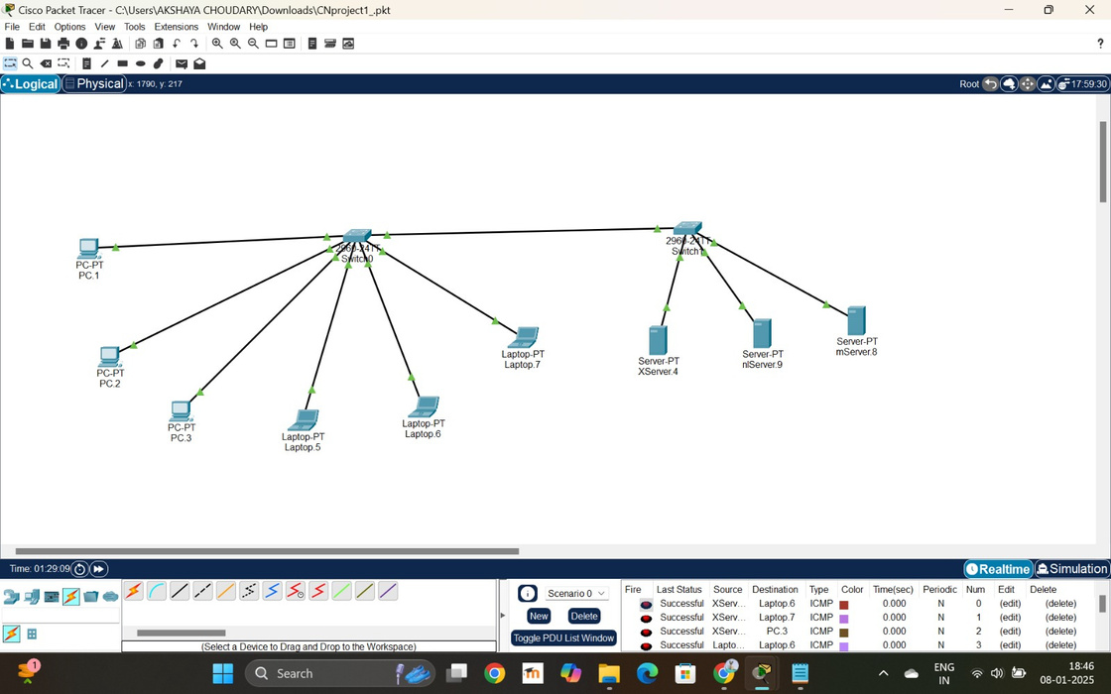
CN PROJECT
STEPS INVOLVED:
Drag and drop Client devices ( PCs and Laptops ) and Servers.
Add Switches to give an efficient connection between the clients and the servers.
Connect all the Client devices to a switch and all the servers to the other using ethernet cables ( copper straight through connection).

Slide 10
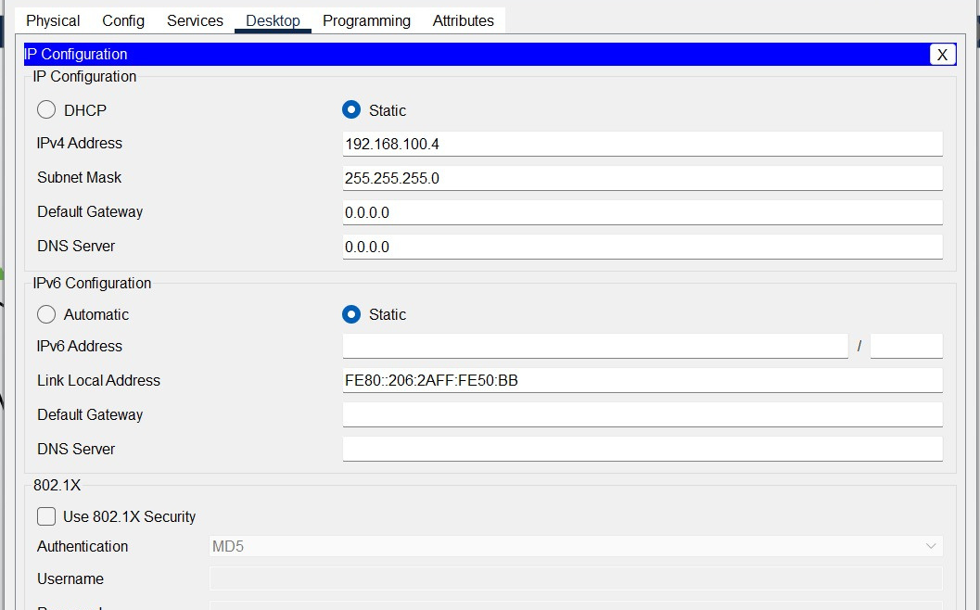
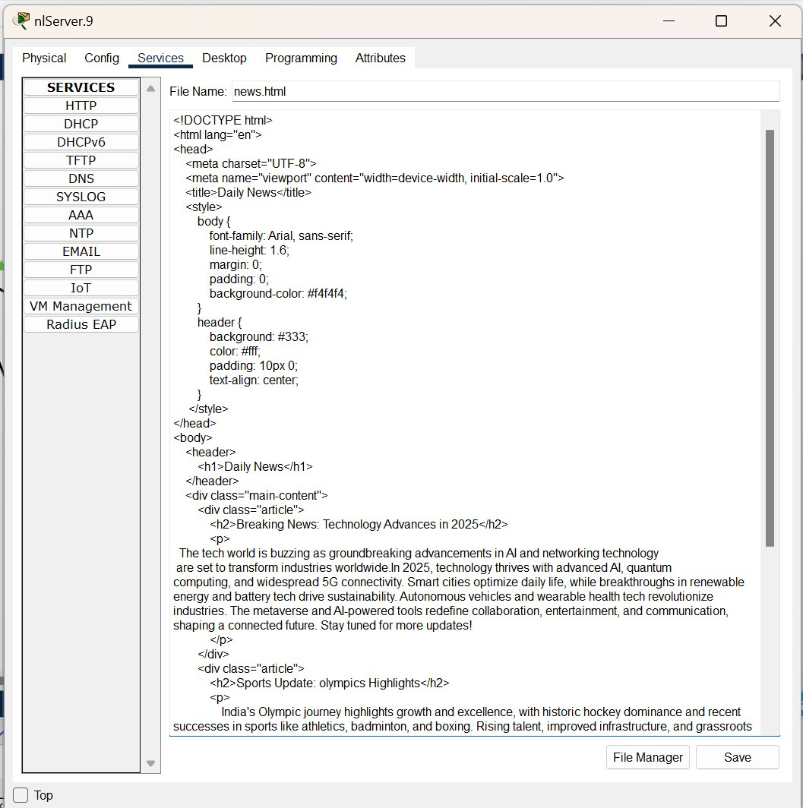
CN PROJECT
Home
Photo
About Us
Contact
STEPS INVOLVED:
3. Set up the IP configurations of each device.(eg:192.168.100.8)
4. Go to servers>services>HTTP and create a new html file.

Slide 11
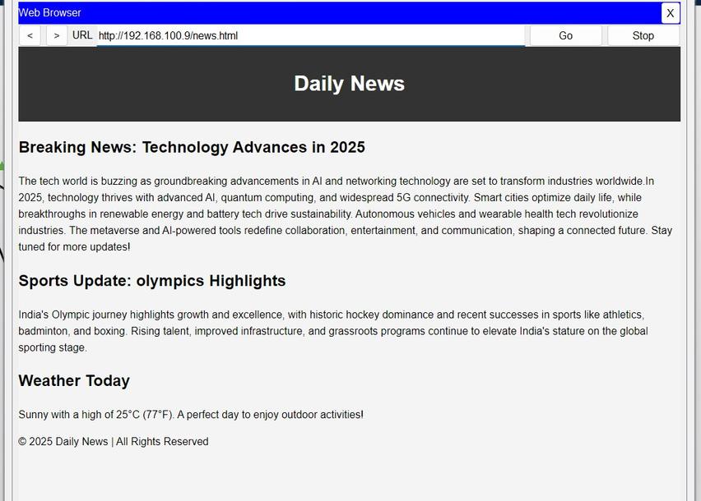

CN PROJECT
Home
Photo
About Us
Contact
STEPS INVOLVED:
5. click any of the client devices, go to web browser and search the server IP address.
6. The result of the html code is displayed.
7. search IP address/ filename.html to load other files in the corresponding server.
8. Multiple services can be provided using multiple html files and servers.

Slide 12
CN PROJECT
In conclusion, integrating HTTP with web services enables
seamless communication,
scalability, and
interoperability between diverse systems.
This model allows for
efficient data exchange,
flexible integration across platforms,
making it an ideal solution for scalable and maintainable applications.

Slide 13
CN PROJECT
THANK YOU

